Slide 1
Applied Data Science Capstone Project
- The Battle of Neighborhoods
Discovering Top Venues in Scarborough, Toronto, Ontario, Canada
08/12/19

Slide 2
1
Introduction
CONTENTS
2
Data Review
3
Methodology
4
Results
5
Discussion

Slide 3
Part 1 Introduction
1. This project is aimed at recommending places to chill out (entertainment, accommodation, restaurant, etc.) for people visiting the neighborhood of Scarborough.
2. The recommendation system is built on Foursquare dataset, geographical data, and venue information of Scarborough from the internet.

Slide 4
Part2
Data Review
1. The datasets used in this project mainly come Wikipedia page in tabular format, including postcodes and neighborhoods, as well as geographical information from Geospatial_Coordinates.csv. Detailed information of local venues obtained from Foursquare.com are the core materials of this analysis.
2. Reshaping the geographical data and adjusting the venue information allow us to make comparisons based on the location, the name, and the category of assorted venues.

Slide 5
Part 3
Methodology
Download and transpose the data into pandas dataframe
Clean the data (dropping and regrouping)
Use Foursquare dataset to obtain venue information
K-means clustering

Slide 6
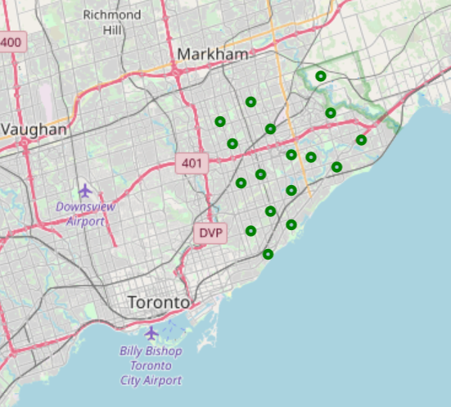
Part 4 Results

Slide 7
Part 4 Results
Most of the sixteen neighborhoods explored have at least one eating spot and one chill-out spot in their top three common venues, while shopping spots are much less common, which is expected.

Slide 8
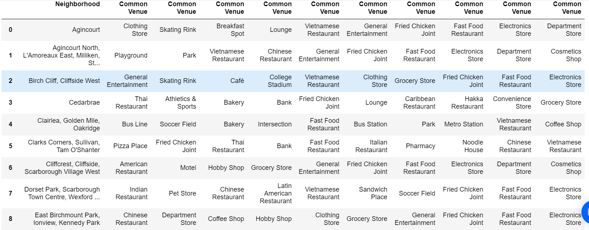
Part 5
Discussion

Slide 9
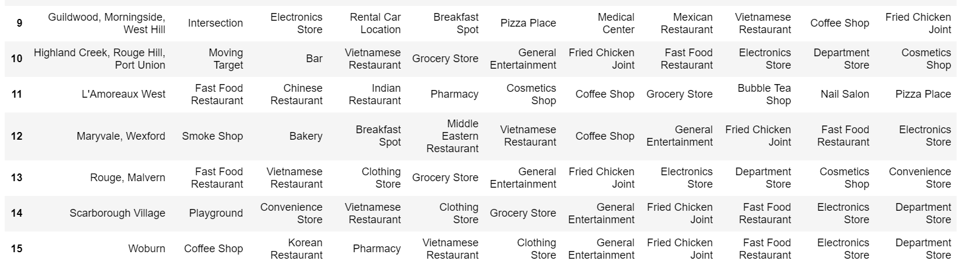
Part 5
Discussion

Slide 10
Part 5
Discussion
It is fairly obvious that western restaurants and Asian cuisines are most common (and likely to be popular) in all these neighborhoods. In addition, lite shopping spots and places to chill out are also welcomed in all the areas, indicating that these neighborhoods should be visitor-friendly and sportive.

Slide 11
Part 6
Conclusion
The neighborhoods of Scarborough are indeed of high cultural diversity and have well established public constructions that suit both visitors and residents for their needs. Tourists fond of outdoor activities, lite shopping, and Asian/American cuisines should be able to enjoy their trips to Scarborough.

